Slide 1
Are there indicators of a housing bubble in Sweden?
IBM Applied Data Science Capstone Project

Slide 2
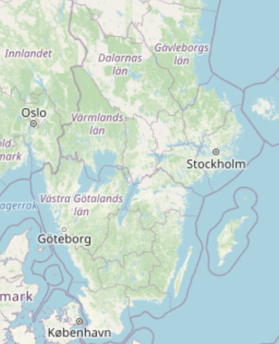
Overview
Introduction
Data requirements and sources
Methodology
Results
Discussion
Conclusion

Slide 3
Introduction
Business Background and Problem
Housing market is an important pillar of the Swedish economy
A high level of inhabitants in Sweden invested a significant share of their savings in housing and many are in debt to afford housing.
Housing prices have been skyrocketing in Sweden over the years, now there are several recognized experts claiming there might be a bubble in the market.
Target Audience
Anyone that invested or considers investing in the Swedish housing market

Slide 4
Data requirements and sources
Relevant Data
Supply, demand and prices in the housing market
Swedish economic development
Development of interest rates and availability of credit
Outlook of current or future development of these factors
Data sources
Swedish Statistical Institute, Swedish Central Bank, trusted web resources of official institutions

Slide 5
Methodology
Exploratory data analysis of existing statistical data of the housing market in Sweden.

Slide 6
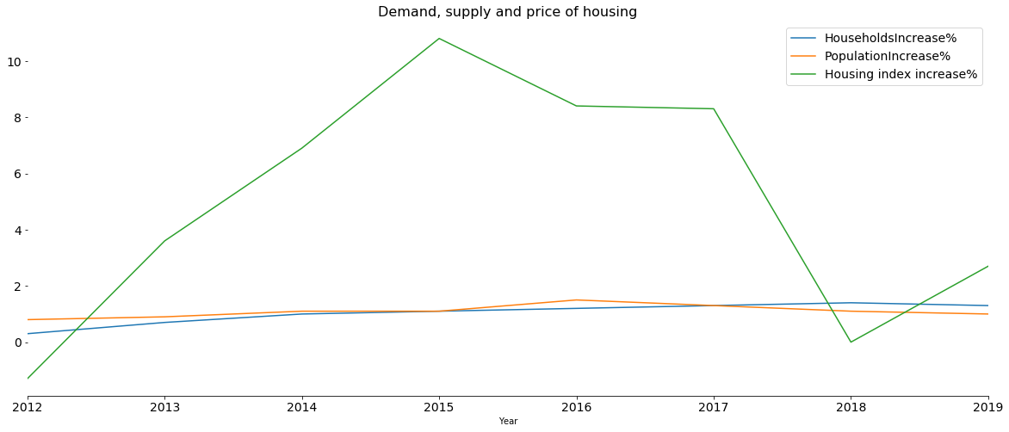
Methodology

Slide 7
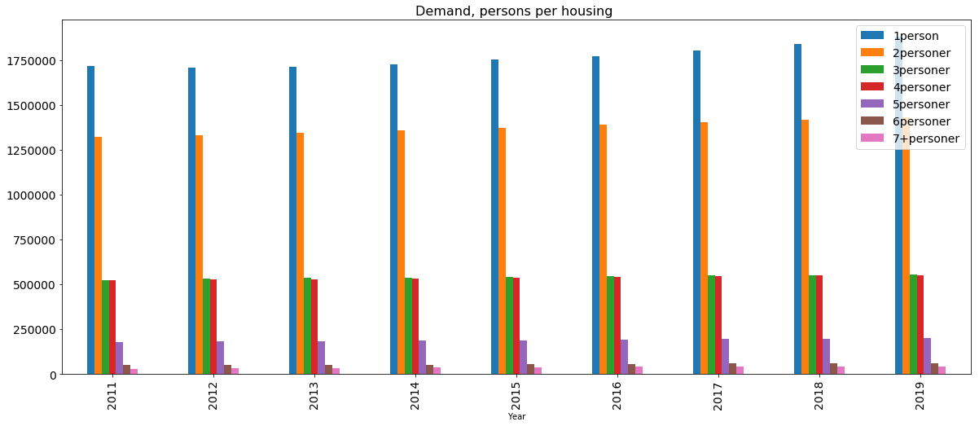
Methodology

Slide 8
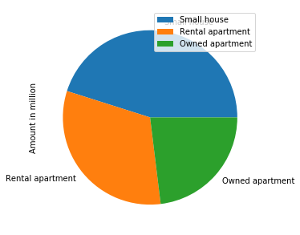
Methodology

Slide 9
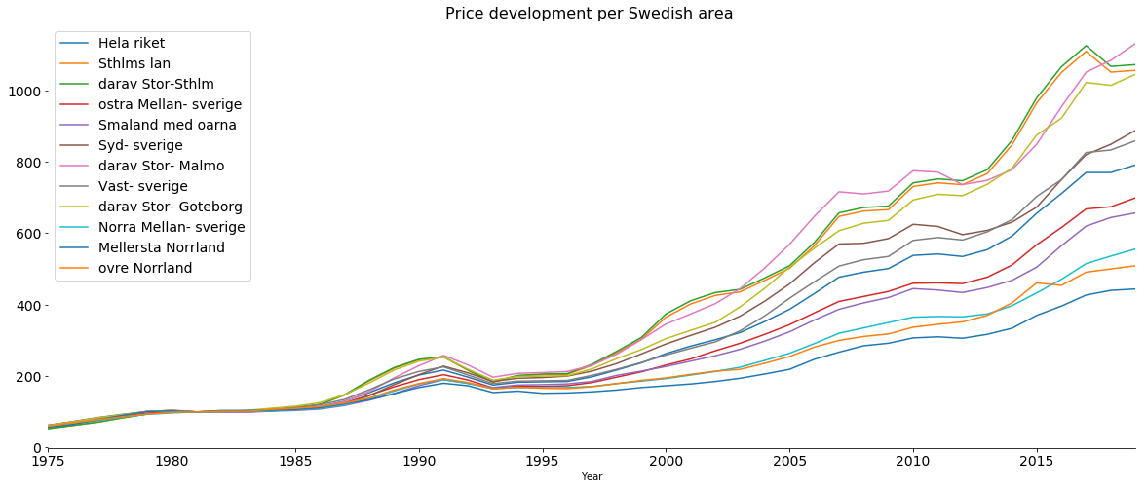
Methodology

Slide 10
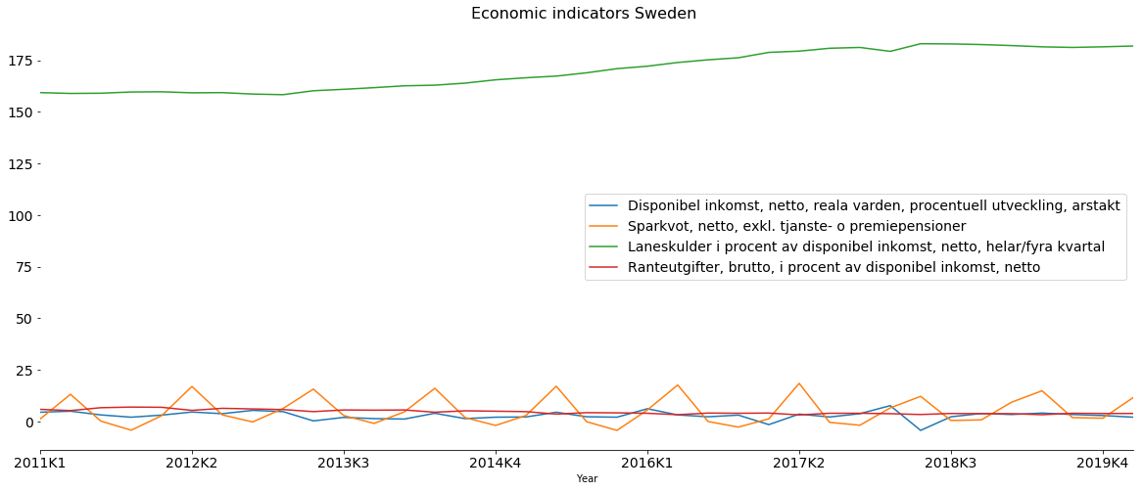
Methodology

Slide 11
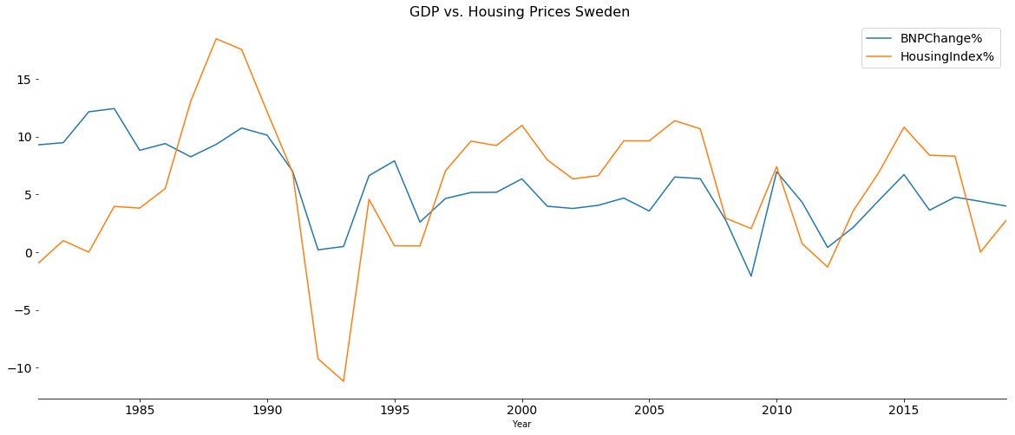
Methodology

Slide 12
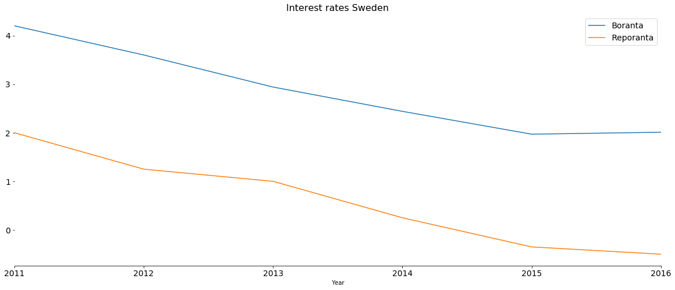
Methodology

Slide 13
Results
Factors for a housing bubble identified in all areas of Sweden
Inflated prices
Economic prosperity
Low interest rates
Easily accessible credit
Covid-19 might trigger a crash due to
Downturn in economy
Rising interest rates
Drop in demand

Slide 14
Discussion
Although indicators of a housing bubble were identified, market manipulating factors, e. g. governmental programs, can keep it from bursting.
Data analysis in this project very simplified for a complex problem.
Risk of housing bubble not in Sweden alone (see next slide).

Slide 15
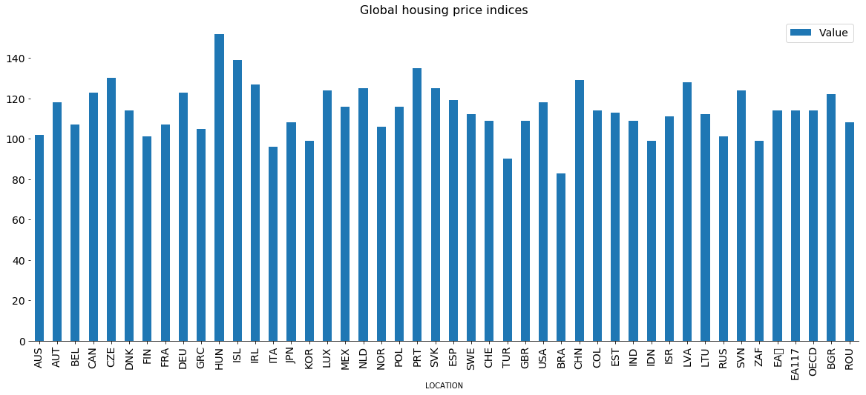
Discussion

Slide 16
Conclusions
There are indicators for a housing bubble in Sweden.
Covid-19 effects might trigger it to burst.
Investors should be aware of this risk.

Slide 17
Thank you for your attention!

